Slide 1
Git Workflows

Slide 2
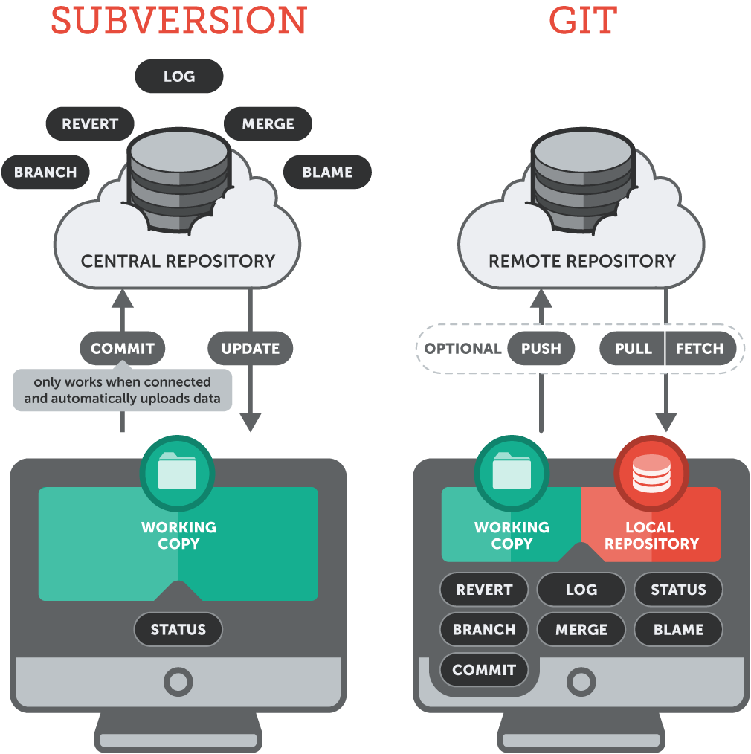
Centralized Vs Distributed VCS

Slide 3
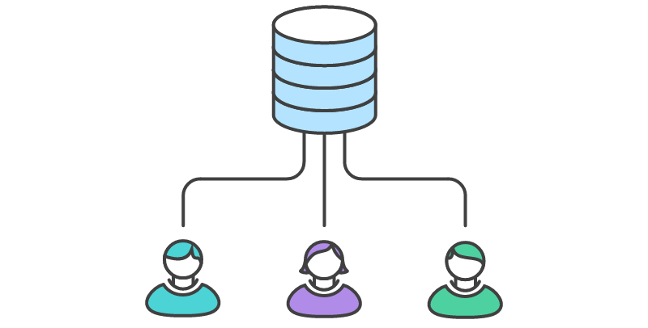
Centralized Workflows
Notes:
https://www.atlassian.com/git/tutorials/comparing-workflows/centralized-workflow

Slide 4
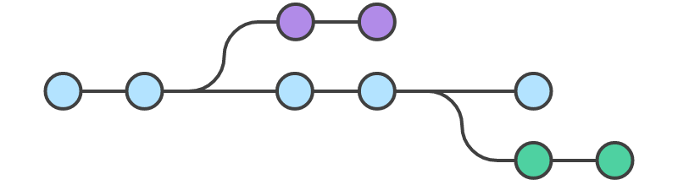
Centralized Workflows | Feature Branch
Notes:
https://www.atlassian.com/git/tutorials/comparing-workflows/feature-branch-workflow

Slide 5
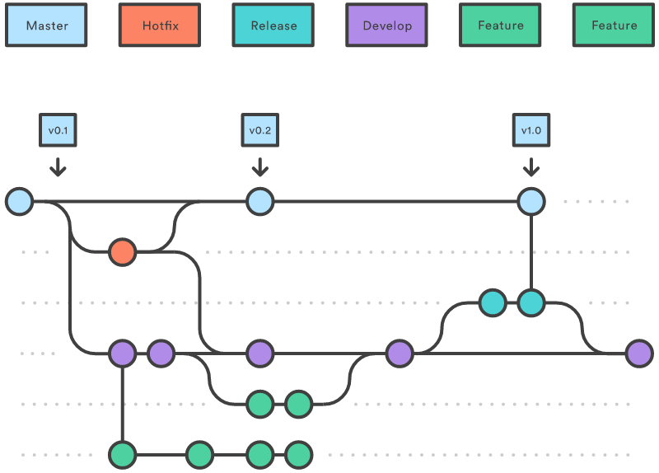
Centralized Workflows | Feature Branch
Notes:
https://www.atlassian.com/git/tutorials/comparing-workflows/gitflow-workflow
2 Branches
Master : Stores official release history
Development : Acts as an integration branch for features
All commits in master branch are tagged
Feature branch : Spinned off from development branch and merged back into develop branch
Release branch : Once you reach a state of delivering your software you spin off release branch. After that bug-fixes should go into feature branch and finally it should be merged into master and then into develop

Slide 6
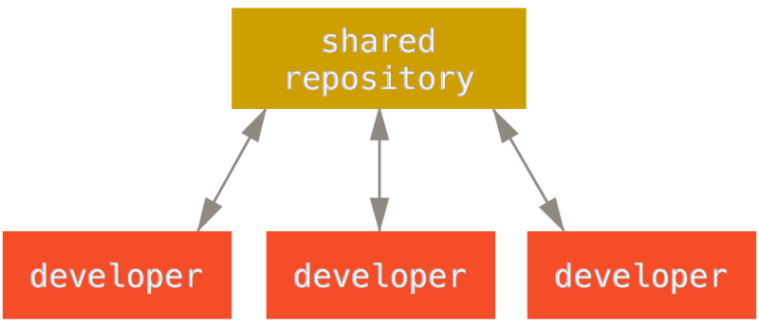
Distributed Workflows
Centralized Workflow

Slide 7
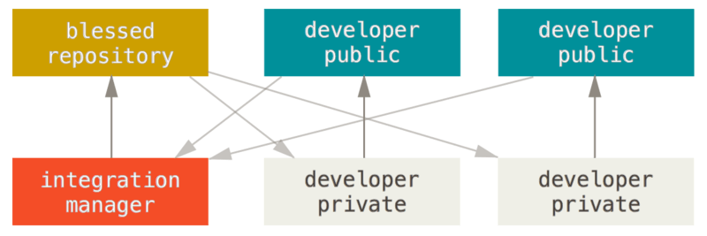
Distributed Workflows
Integration-Manager Workflow

Slide 8
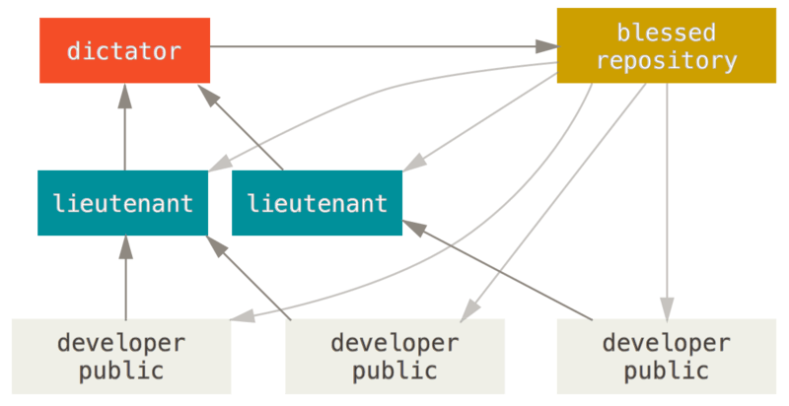
Distributed Workflows
Dictator and Lieutenants Workflow

